Slide 1

Twitter Bot Detection
By
Jayesh Patil (jpp421)
Sanket Nawle (skn288)
Under the guidance of: Prof. Gustavo Sandoval

Slide 2

Contents
Introduction
Motivation
Dataset
Initial inspection of dataset
Algorithms and their performance:
KNN
Random Forest
Ada Boost
Gradient Boost
Conclusion

Slide 3
Introduction
Twitter is an online news and social networking service where users post and interact with messages, “tweets”, restricted to 140 characters
There are a 310M monthly active Twitter users and a total of 1.3 billion accounts have been created. There are about 500 million tweets sent per day.
Since, Twitter can be such an influential platform, people have developed programs known as twitter bots.
These bots can be used in a variety of ways such as for increasing number of followers, spamming, retweeting, etc. This practice is becoming so popular that it is estimated that there are about 48 million twitter bots already.

Slide 4
Introduction (continued)
The main aim of this project is to distinguish twitter bots from real accounts
This is done using various machine learning algorithms after fetching information of about 1000s of Twitter accounts using REST API (Tweepy) that provides us the values of following attributes:
user_id
name
status_count
created_at
location
description
.................
7) followers_count
8) url
9) bots (0/1)

Slide 5
Motivation
Social media has been one of the most used form of communication these days.
Statistics:
83% of the Americans have some kind of social media account. 86% of Twitter users rely on the site for the latest news. 91% of retail brands use two or more social media services to publicize their product. More than 130,000 advertisers use Twitter actively.
In order to take advantage of this massive community, people have developed twitter bots.
According to a study released by University of California, these bots contribute to approximately 24% of the total tweets on Twitter.
So, when you think that you are having a conversation with a person on twitter, it may happen that it is actually just a bot program.
These twitter bots are usually benign and silly, but it may not be long enough when we start having bots which are smart enough to fool people.
Thus, it would prove to be beneficial to distinguish bots from people on twitter.

Slide 6
Dataset
The data consists of different attributes related to corresponding twitter accounts
The data was fetched using the Twitter REST API and was stored in a CSV file using a python script.
The dataset consists of 1056 bot accounts and 1176 user accounts.
Types of attributes:
Integers: Id, Id string, friends, followers count, listed count, favorites and statuses count
Strings: screen_name, location, description, url, name and language
Boolean: verified, default profile, default_profile_image and has_extended_profile
Date: created_at
JSON: status

Slide 7
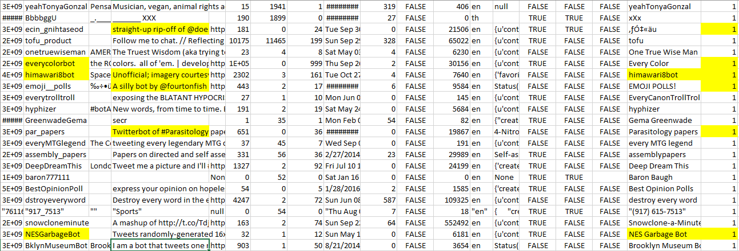
Initial inspection

Slide 8
Initial inspection(continued)
Derived attributes:
Age (using date library) – based on created_at attribute
Bot in name (using screen name, name and description attributes)

Slide 9
KNN Classifier
Given a set of training samples, KNN classifier doesn’t build any classification model; the training set itself is used for classification
It is also called as a lazy learner.
When the unknown sample is given, its distance from each of the known samples is calculated and ‘k’ no. of closest neighbours are further considered
The unknown sample is then placed in the class which is most common amongst the nearest neighbours

Slide 10
Random Forest Classifier
Random Forests are an ensemble learning method that construct a number of decision trees at training time and outputting the class that is the mode of the classes output by individual trees
Single decision trees often have high variance or high bias. Random Forests attempts to mitigate the problems of high variance and high bias by averaging to find a natural balance between the two extremes.
When the training set for the current tree is drawn by sampling with replacement, about one-third of the cases are left out of the sample. It is also used to get estimates of variable importance.

Slide 11
AdaBoost Classifier
Boosting is a general ensemble method that creates a strong classifier from a number of weak classifiers. AdaBoost was the first really successful boosting algorithm developed for binary classification
AdaBoost can be used to boost the performance of any machine learning algorithm. The most suited and therefore most common algorithm used with AdaBoost are decision trees with one level. Because these trees are so short and only contain one decision for classification, they are often called decision stumps.
Predictions are made by calculating the weighted average of the weak classifiers.

Slide 12
Gradient boost classifier
The basic principle of gradient boost classifier is same as that of adaboost, i.e., using the idea of using different weak classifiers and building a strong one
Gradient boosting involves three elements:
A loss function to be optimized: depends on the type of problem being solved.
A weak learner to make predictions: Decision trees are used as the weak learner in gradient boosting.
An additive model to add weak learners to minimize the loss function: Trees are added one at a time, and existing trees in the model are not changed.
It can benefit from regularization methods that penalize various parts of the algorithm and generally improve the performance of the algorithm by reducing overfitting.

Slide 13
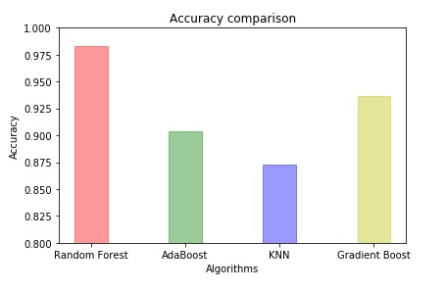
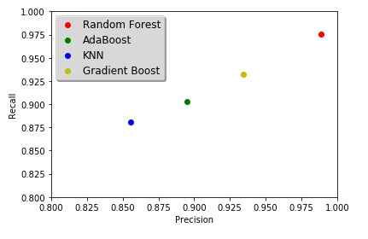
Measuring Performance

Slide 14
Future scope
Use of clustering algorithms to find interesting patterns
Using those patterns, we could have added different constraints and adjusted the threshold of the algorithms
using a combination of different algorithms and performed the classification based on the accuracy of each classifier

Slide 15
Thank You!!

